Slide 1
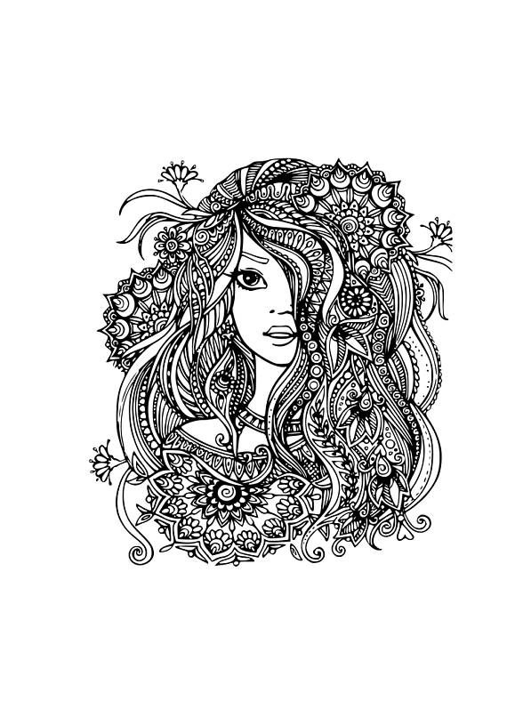
gTangle
A Grammar for the Procedural Generation of Tangle Patterns
Lab Team
Aman Goel | CSE | 2018101005
Ammar Ahmed | CSE | 2018101058
Aryamaan Jain | LCD | 2019121002
Jyoti Sunkara | CSE | 2018101044
Mentor
Prajwal Krishna Maitin
URL
https://github.com/Digital-Image-Processing-IIITH/project-lab-team

Slide 2
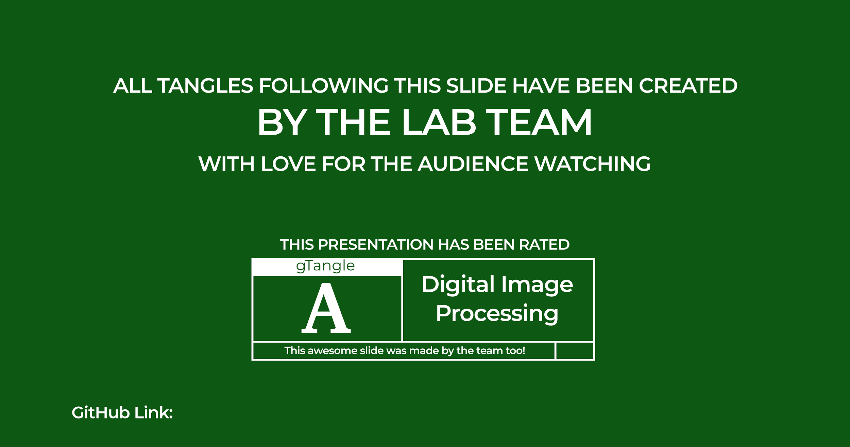
Outputs Drive Link: shorturl.at/gyFI1

Slide 3
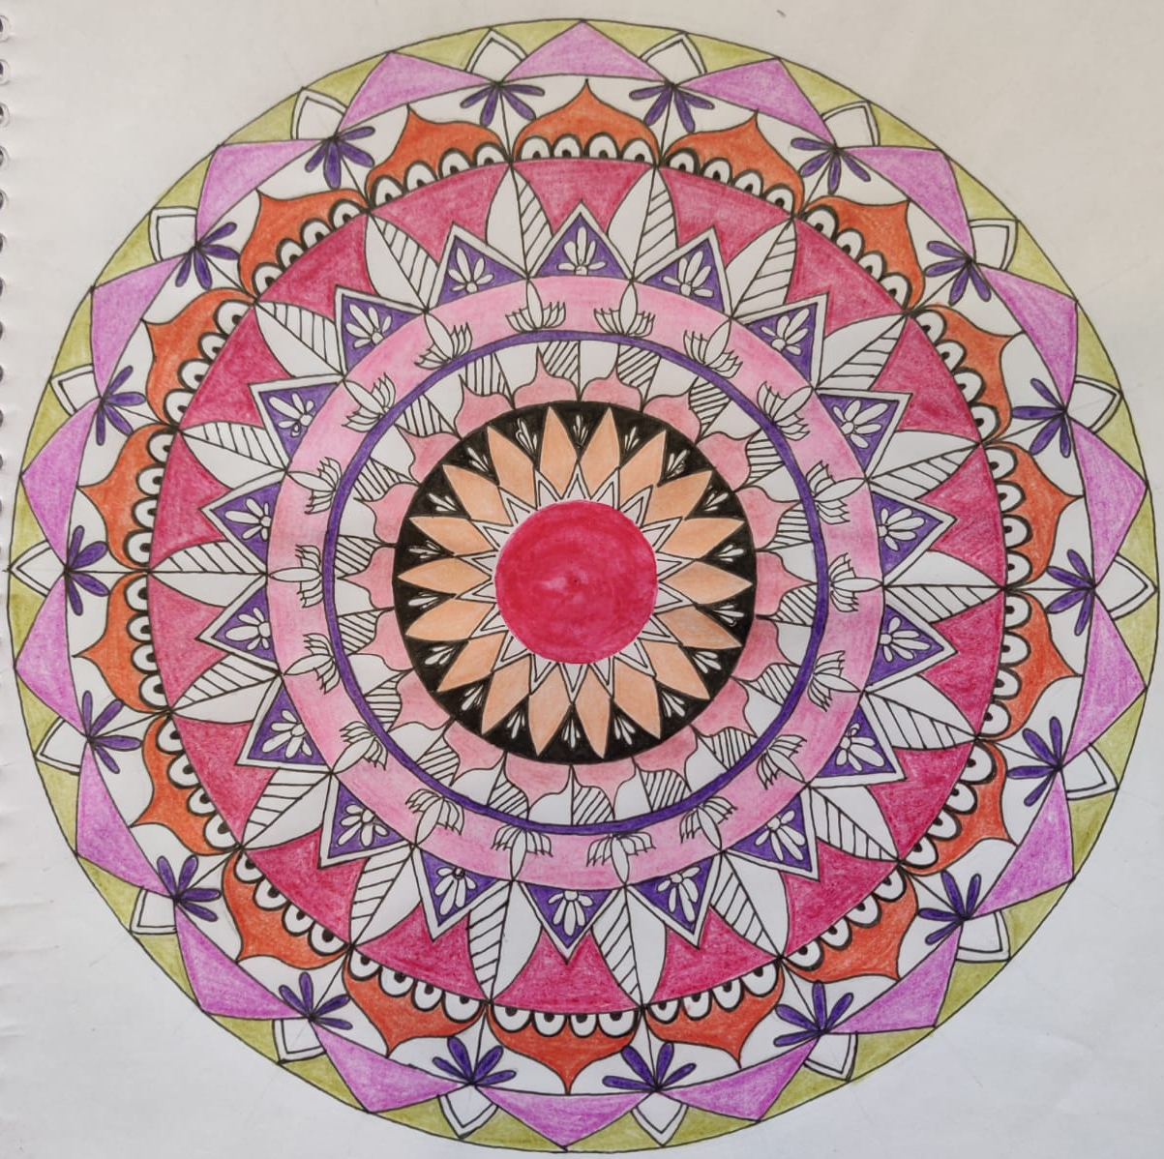
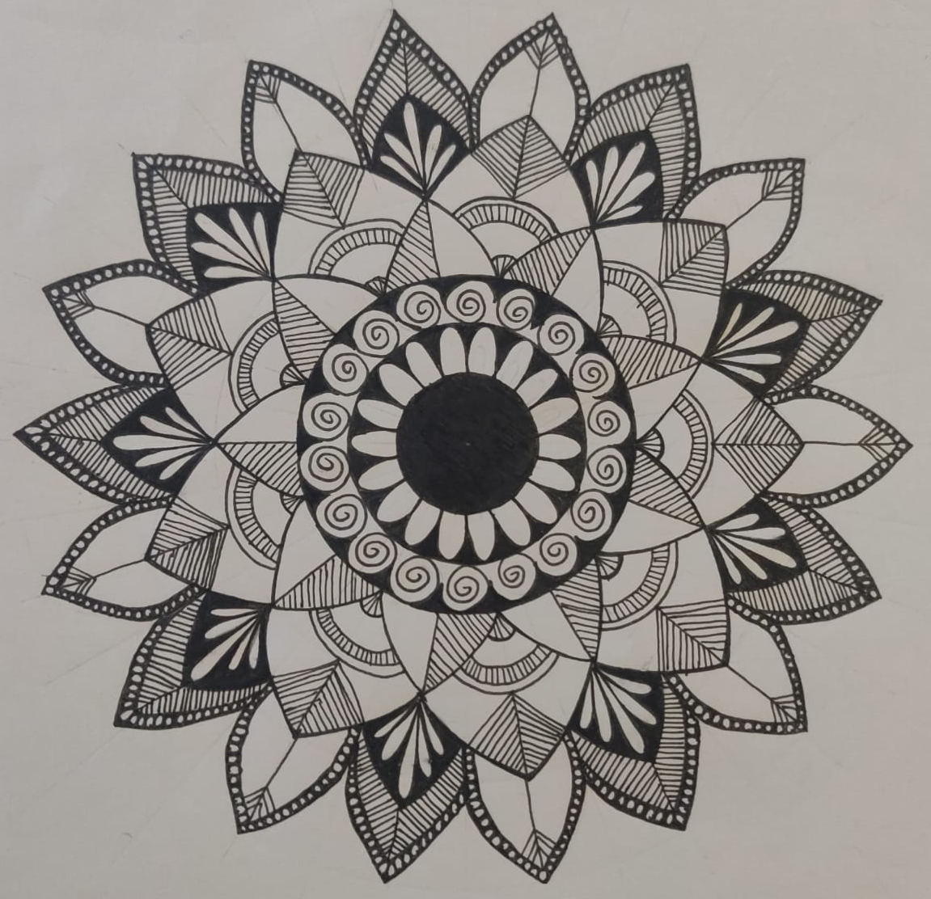
Tangles are a form of two dimensional structured pen and ink art created by a small set of basic strokes:
Dots
Straight Lines
Curves
Shapes
Notes:
A tangle pattern is a interwoven tapestry of basic stroke patterns, like dots, straight lines, simple curves and shapes. If we look at some of these works, we see that many of them are highly structured and this sparks the idea that maybe, we could automatically create such beautiful structures with a computer!Their complexity comes from the repetition of those strokes, to form structured patterns drawn recursively at different scales.
This paper is about simplifying this process by bringing in grammars.

Slide 4
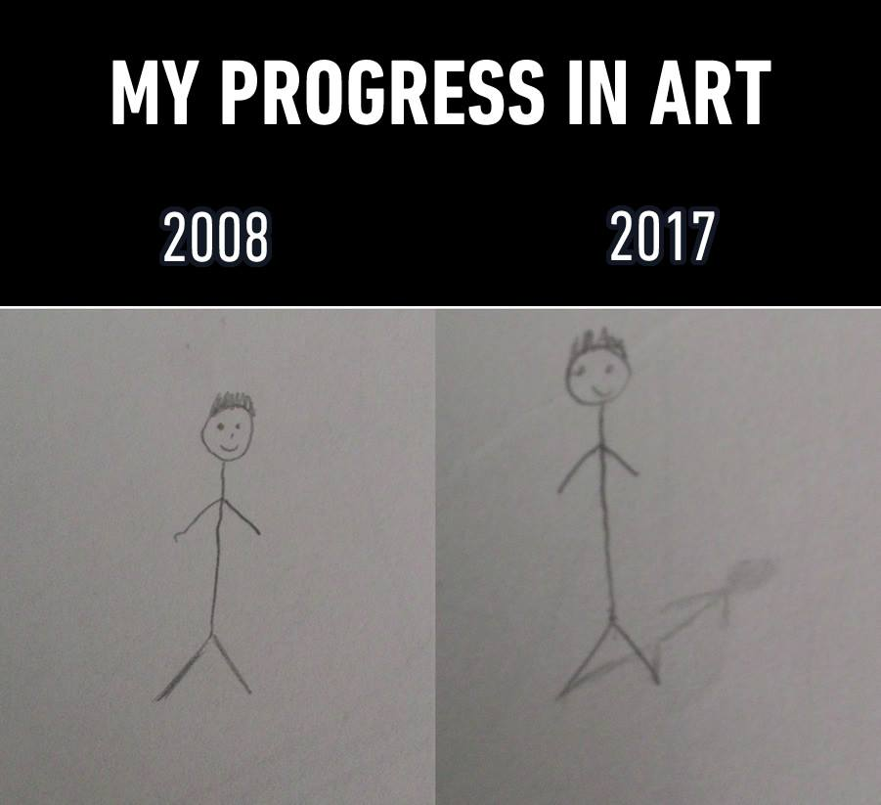
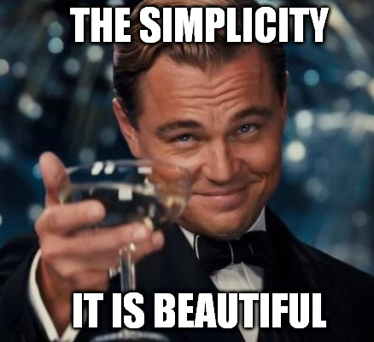
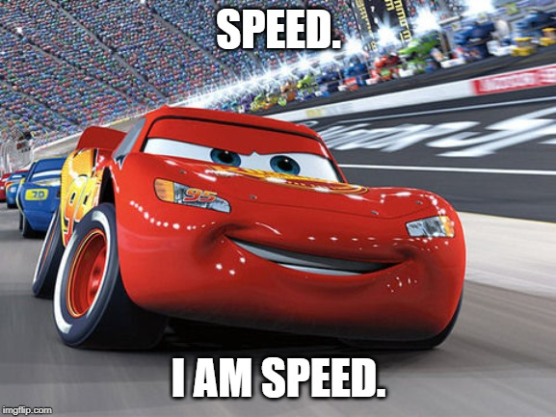
Purpose
Artistry
Tangles take artists hours of tedious and time-consuming work and precision which can now be done quicker and with fine control by even non-artists!
03
Group Grammars Simplicity
Expressing complex tangles patterns and sub-pattern distributions, with relatively simple grammars.
01
02
Speed
Group grammars can efficiently produce a wide variety of patterns!
Notes:
The purpose of this method is threefold.
One it brings mathematical simplicity to the process,
Two it is much more efficient that actually waiting for an artist to spend hours and days to create work like this
Third it's usable by every person irrespective of how good or bad they are at art!

Slide 5
Tangles / Zentangles / Mandalas
The tangles are generated by recursively splitting and combining initial set of polygons, using group grammars that perform operations on the polygons.
Notes:
Known by many names such as tangles/ zentangles/ madalas.
The aim now is to generate them using group grammars that perform operations on polygons. And now we’ll slowly define all the words used in that sentence.

Slide 6
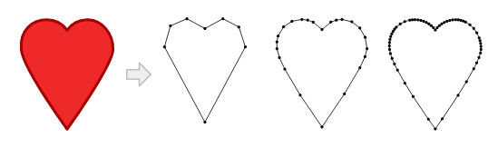
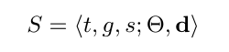
Shapes
Geometric Shape
Grammar Shape
Notes:
For the purpose of this paper every geometric shape is arbitrary 2D polygon where their boundaries are represented as highly-tessellated closed curves. This just means that the smallest primitive is always a straight line. Even a curve is created by joining many of these small line together.
Each shape is represented as a tuple <t, g, s> where t is the shape tag, g is the group id and s is the shape id. Its additional attributes Θ, the list of curves describing the boundary of the polygon, and a unit vector d, that defines the orientation of the shape are used for drawing the SVG.

Slide 7
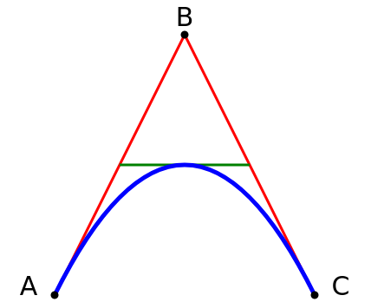
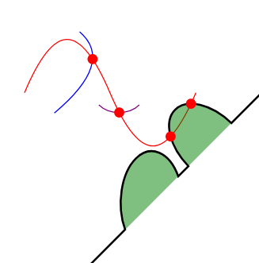
Scalable Vector Graphics
Bézier path
Intersections
Notes:
SVG images and their related behaviors are defined in XML text files, which means they can be searched, indexed and scripted. And hence they can created and edited with any text editor or with drawing software.
Two key concepts used in SVGs are:
Quadratic Bézier curve, where A and C are the start and end points, B is the control point!
<polyline> element can be used to create lines, curves, arcs, and more using straight lines. Just like in HTML the
<id> property in XML is used to set the tags to a path enclosing an area.
Intersections of paths. This was most used in the perturbation of the shapes where a grid of intersections was used to add noise to the image.

Slide 8
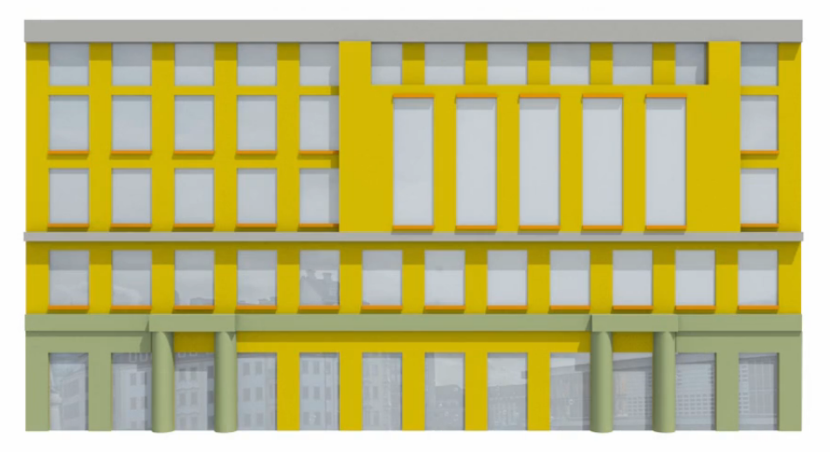
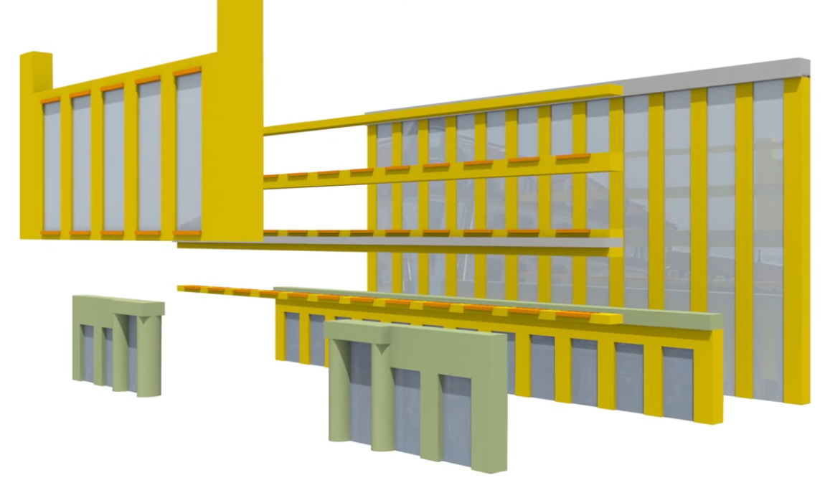
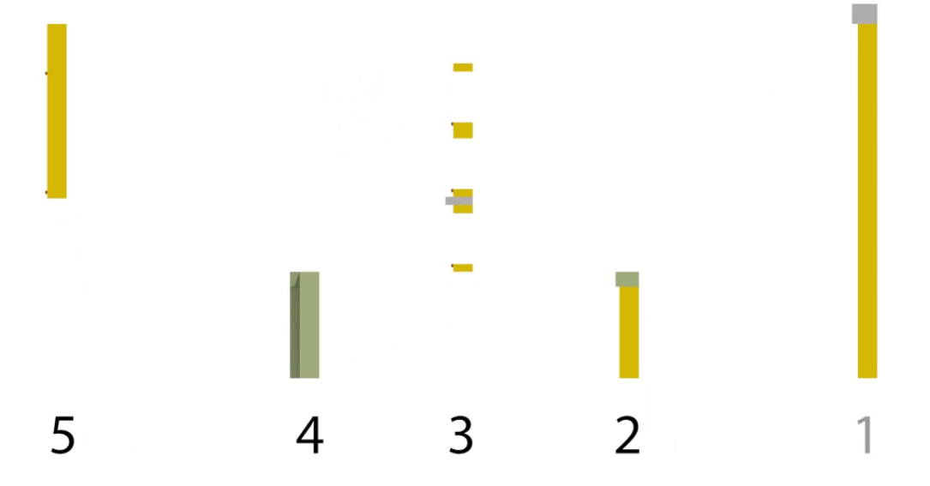
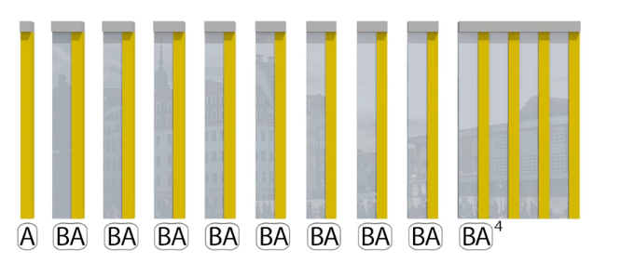

Grammar
Layer-Based Procedural Design of Facades, 2015
cg.tuwien.ac.at/research/publications/2015/Ilcik_2015_LAY/
General Production Rule
Notes:
Grammars are a set of rules that tell us how to build up a structure, such as a sentence properly from small elements, like nouns, adjectives, pronouns, and so on. Grammars have set up rules that enforce that every mathematical expression satisfies a number of desirable constraints.
Grammar are a way to mathematically simplify the most complex structures existing. For instance, a shape grammar for buildings can describe rules like a wall can contain several windows, below a window goes a window sill, one wall may have at most two doors attached, and so on.
In group grammars, a production R is expressed in the following form where O is the tangle operator that will be used when the rule is applied, {p_{o} } the operator parameters, t_{m} is the tag that will be used to select the matching shapes

Slide 9
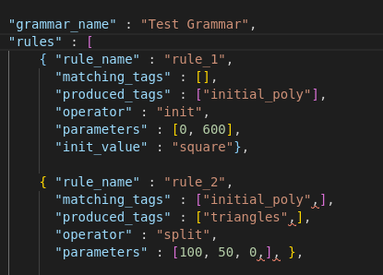
JSONs
The grammar here is initializing a square and performing the split operation on the square!
Notes:
This is how the grammar is represented in the code, as a JSON
We can see a few things, rule_1 is to initialize the tags in a square, this is done using a GUI later so we can skip this for now.
rule_2 is splitting the square in one iteration
This creates shapes which are tagged as triangles
The operator as mentions is ofcourse the split operator and it takes three parameters in this manner.

Slide 10


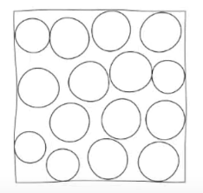
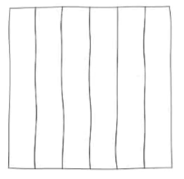
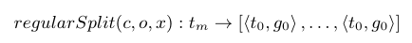

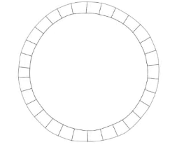



Operators
Grouping Operators
Geometric Operators
Notes:
The operators applicable during the expansion process are subdivided into three main categories:
(1) grouping operators, that don’t actually modify any shape, but only re-label sets of shapes by manipulating their group and shape ids
(2) geometric operators, that subdivide shape groups by splitting, outlining and placing objects in them
(3) decorative operators that simply modify the final appearance of a shape
Filling that sets the background color of a shape and
Stippling that stipples the shape with geometrical details like dots, dashes, curves
These mathematical hieroglyphs represent the operations that can be performed on the shapes!

Slide 11

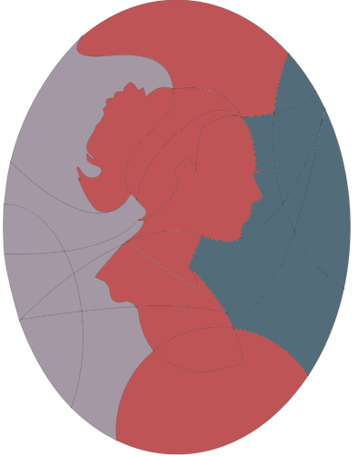

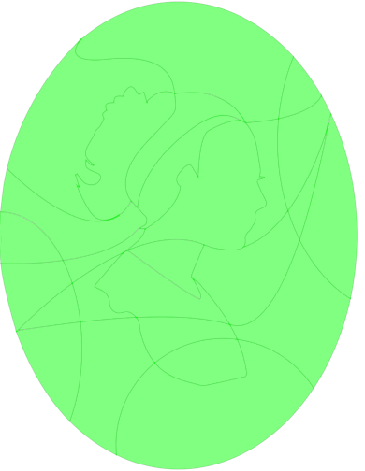
Grouping Operators
Without Regrouping
Regroup By 1
Regroup By 3
Ungroup
Notes:
In this piece of work, we start out with an input shape, subdivide it into multiple other shapes, assign these smaller shapes into groups.
Regroup rearranges the shapes of a selected group into multiple newly created groups, assigning them accordingly to the operator parameter k.
G = S mod K
Ungroup operator that takes all shapes and assigns a new group id to each one of them!
And the final tangle is obtained by choosing patterns and assigning them to all of these groups.

Slide 12

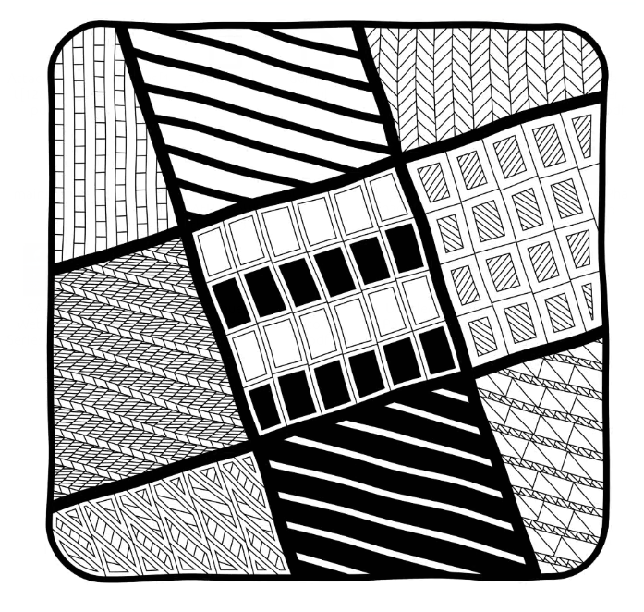
Geometric Operators
Notes:
The regular split operator takes as parameters an arbitrary curve c, a list of offsets o and a flag x. Then, it subdivides
every shape S in S with boolean operations, placing copies of c along the shape orientation d.
The parameter x decides if the split is dual or not: in a dual split, the splitting process is
done an additional time!

Slide 13
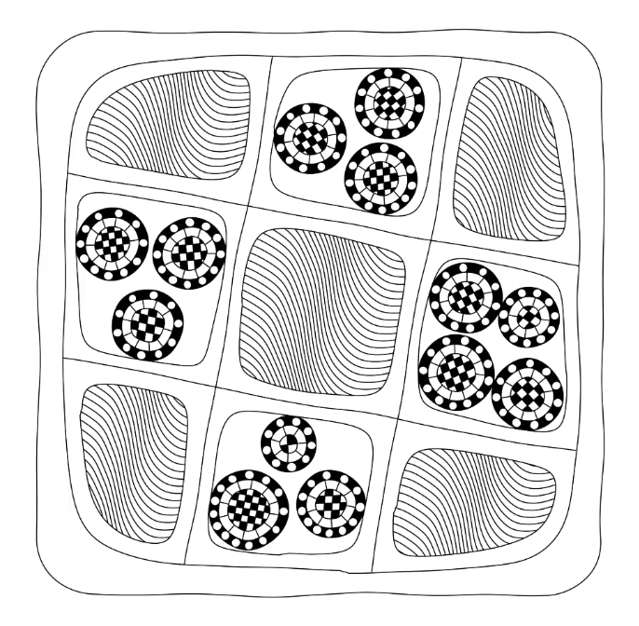
Geometric Operators
Notes:
The parameter type defines what kind of split the operator will perform on the matching shapes, while o is the split
offset. Circular split!

Slide 14
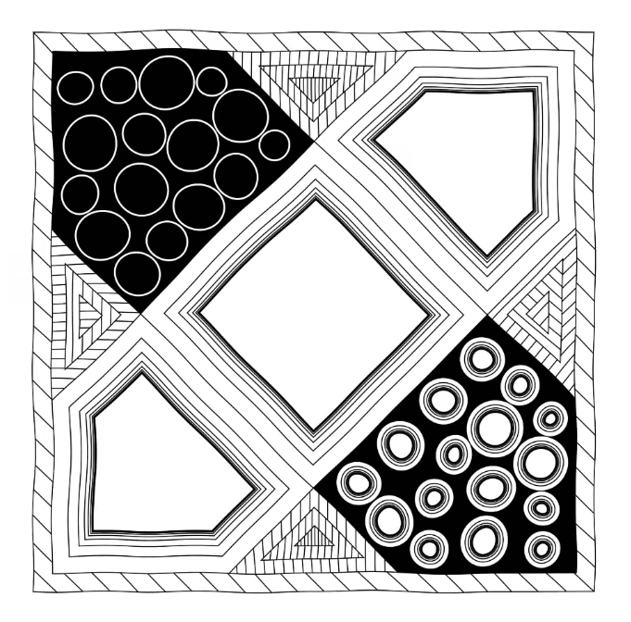
Geometric Operators
Notes:
The outline operator splits every shape in S accordingly to their geometric outline, shrinking the shape borders by a fixed distance d.

Slide 15
Geometric Operators
Notes:
The placement operator distributes an arbitrary shape S in all shapes S!

Slide 16
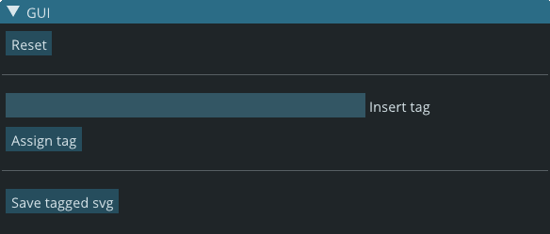
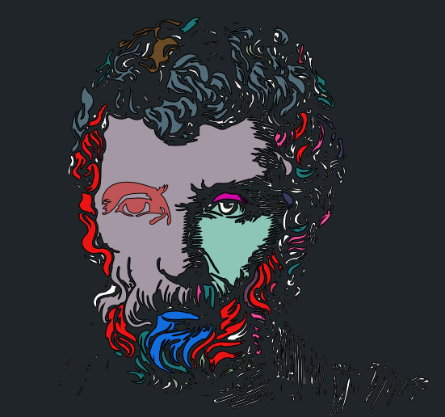
GUI
A user interface to select closed areas in the svg and assign a tag to it!
Notes:
A gui that assigns the initial tages to an svg outline shape. The tagged areas take unique colours and hence makes it easy for the user to identify what has been tagged!

Slide 17
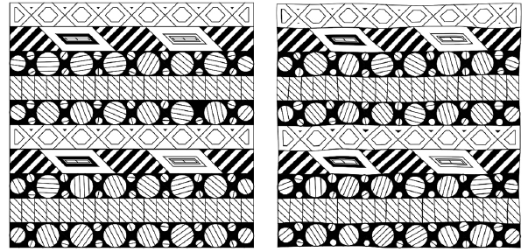
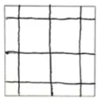
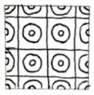
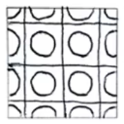
Perturbation
Notes:
Tangles are drawn completely free-handed. To simulate the organic feel of our generated tangles, we apply a perturbation for all subdivided shapes. Since we are dealing with adjacent close polylines, meaningful intersection points and shape adjacencies might be invalidated if perturbation is done improperly.

Slide 18
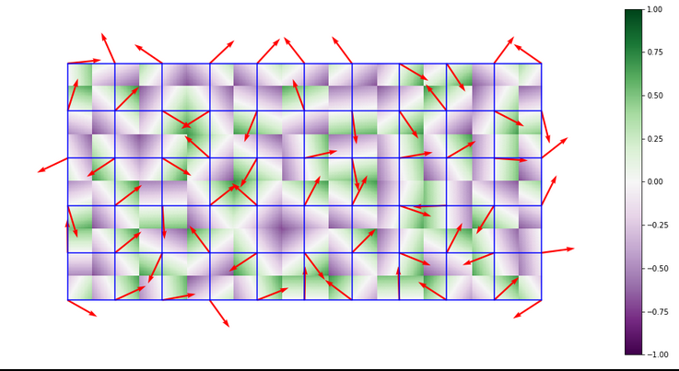
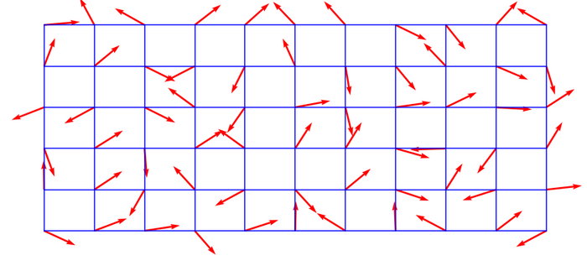
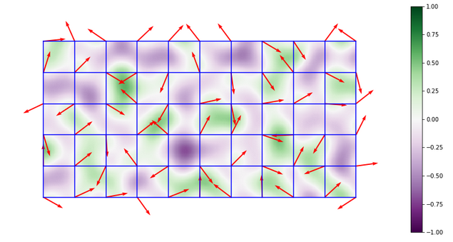

Perlin Noise
Notes:
Coherent noise function that is applied to all shapes with the same group id, by applying a perturbation based on Perlin noise, seeded by the group id. Thus, each point in the shape polyline is perturbed by an amount dependent on the noise function, defined by its amplitude and frequency, that at the moment are designed as constants in our system.
Involves three steps:
Defining a grid of random gradient vectors
A 2-dimensional grid where each grid intersection has associated with it a fixed random 2-dimensional unit-length gradient vector is created.
Computing the dot product between the gradient vectors and their offsets
For each corner, an offset vector is calculated, being the displacement vector from the candidate point to that corner.
For each corner, we take the dot product between its gradient vector and the offset vector to the candidate point.
The computation of 4 offset vectors and dot products happens.
Interpolation between these values.
An example of a function that interpolates between value a0 at grid node 0 and value a1 at grid node 1 is shown here.

Slide 19
Iteration
Shape Perturbation
A coherent noise function that is applied to all shapes with the same group id
2
Decorative Operators
The shapes are filled and stippled
5
111
1
4
Grouping And Geometric Operators
The shapes are grouped, split, placed and outlined
3
Tree
The SVG is stored as a tree data structure after being bisected into the elemental structures
Input
An outline sketch in SVG format is provided as input
Or an SVG outline is created by us.
2
1
2

Slide 20
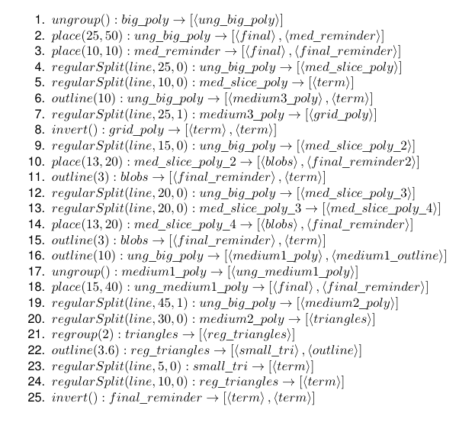
Results
Notes:
The paper yields a very expressive, powerful, tool that anyone can use to create beautiful tangle patterns.
All of this comes through the power of grammars!

Slide 21
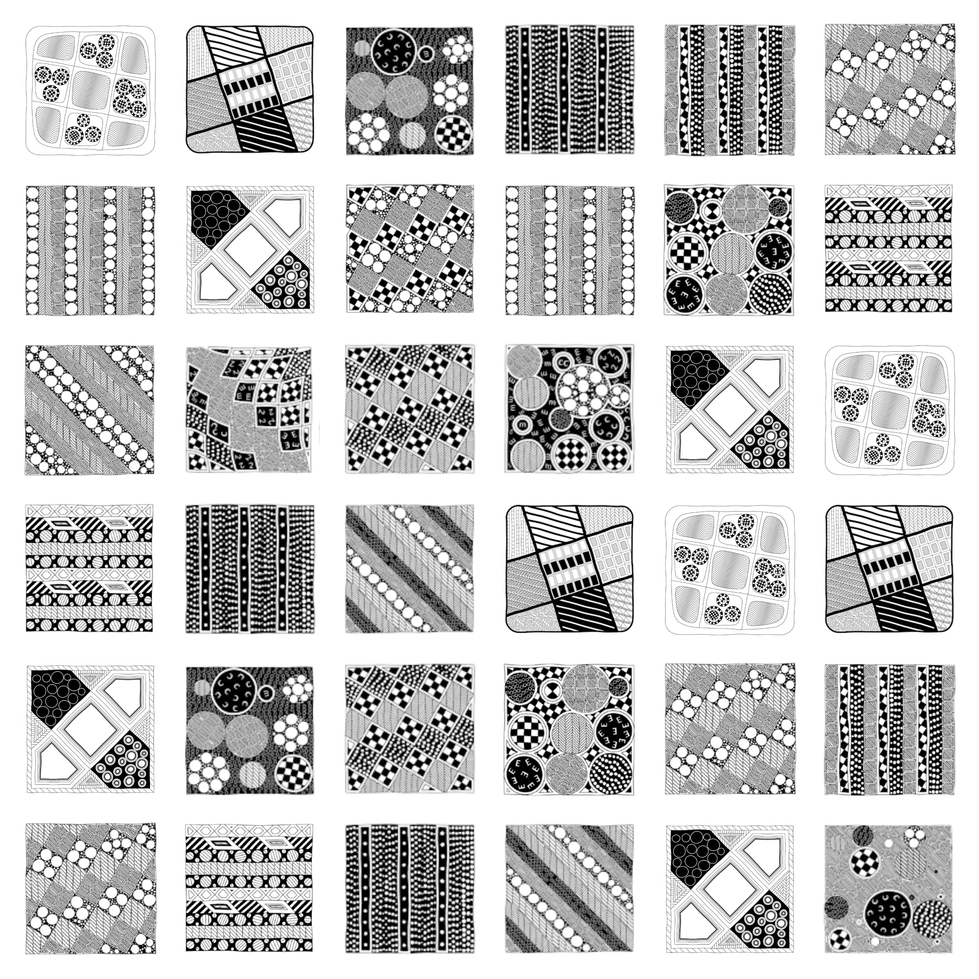
All square tangles on the left have arisen from a single grammar!

Slide 22
Challenges
Challenge 1
Challenge 2
Challenge 3
Collaboration
With the online semester underway the difficulty of communication, debugging, pair programming and explaining code has become manifold.
SVG Graphics
SVG defines the graphics of images in XML format.
The intricacies of SVG images, how they are drawn, stored structured and created and how to create them from code were all new problems for us.
Constructive Solid Geometry Trees
While grammars bring mathematical finesse to the tangles on paper. The representation and manipulation of shapes using a graph in code is a hard problem to solve.

Slide 23

Progress
Overall:
Extra Work:
100%
Animation of the entire formation of the tangles allowing the artist to watch the tangle come to life!
GUI to allow users to tag the SVGs.
Completed!
Notes:
This feature allows the artist to see exactly in which step a particular part of the tangle was created and exactly how it was created!

Slide 24

The Road Taken
We made it!
Proposal Submission
Reading related papers and literature review
Structuring the SVG as a tree.
Reading and parsing rules as JSON objects
Grouping Operators
Geometric Operators
Decorative
Operators
Shape Perturbation
Testing And Creating Tangles!

Slide 25
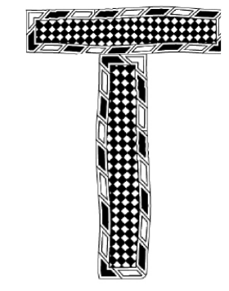


Of these two letters which one was made by us?
Thank you!

Slide 26
Division Of Work
Aman Goel | Coding of operators
Ammar Ahmed | Coding of operators, testing
Aryamaan Jain | Coding of csg tree, documentation
Jyoti Sunkara | Coding operators, csg tree, noise, parsing grammar, generated outputs, documentation

